Slide 1
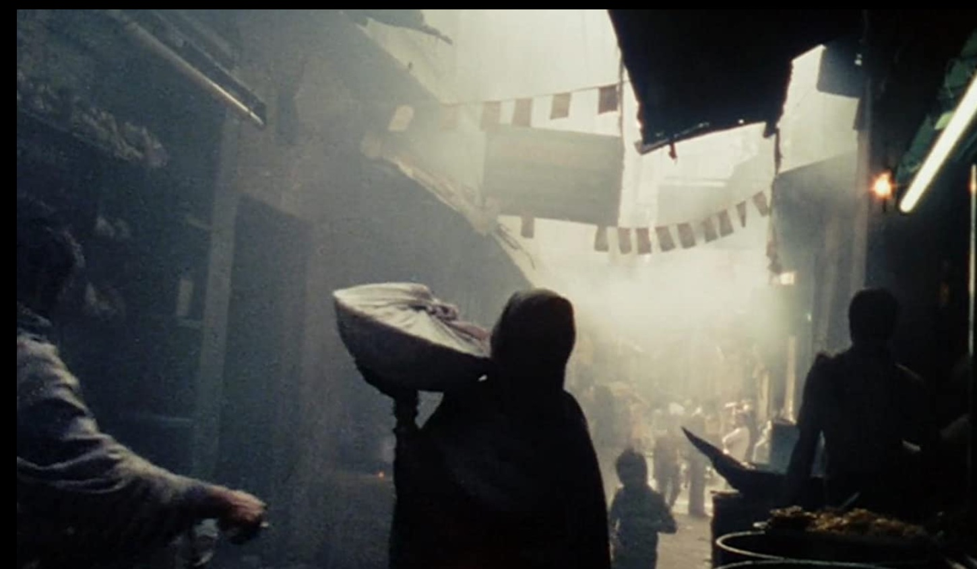
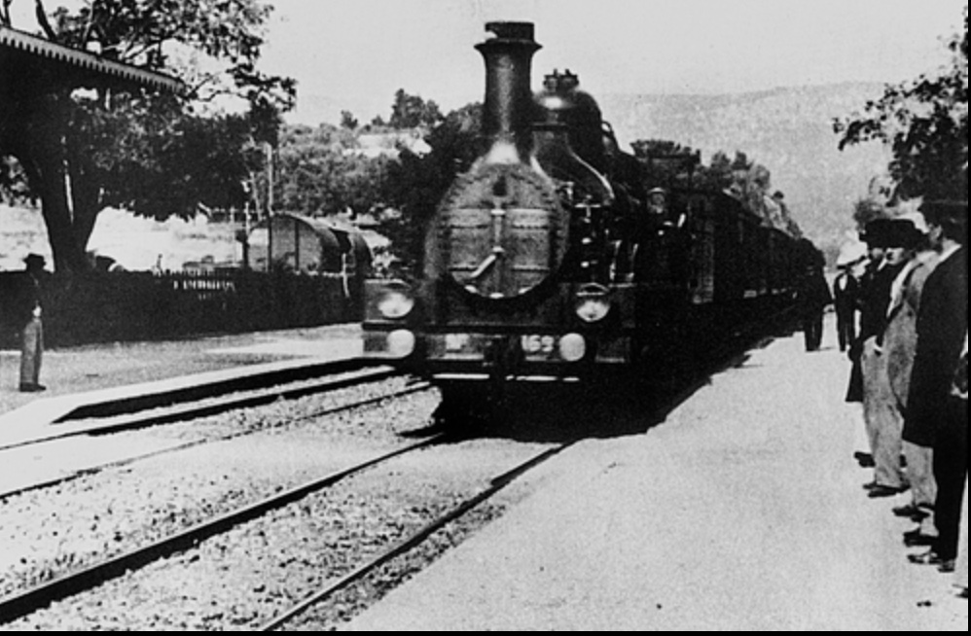
New Virtual Fieldwork Course for SSU Summer, 2021
ANTH 454, Ethnographic Field School: Documentary Interview and Storytelling, Summer of 2021
Great for students majoring in Anthropology, Communications, Counseling, Film Studies, History, Psychology, or Sociology
Summer Session 1, May 25 – June 17 (8 synchronous meetings)
Tuesday and Thursday evenings from 5 PM to 6:15 PM.
Learn about documentary/ethnographic film history
Explore visual/aural storytelling through film
Learn how to write a short film review
Explore interview techniques
Learn (or review) basic video editing techniques
Create your own short group documentary
Showcase your work in your college portfolio

